Slide 1

CLOTHES SHOPPING WEB APP
Team 4 – SE1503 – PRN211
SUMMER 2021
clothesshoppingwebapp20210713203725.azurewebsites.net

Slide 2

Team members
Nguyen Tran Phong – SE150974
Vo Van Thanh Phuc - SE150980
Le Hoang Khoi - SE150854
Tran Tan Long - SE150883

Slide 3

Technologies
ASP.NET MVC 5
Entity Framework Core
Azure Database Server for MySQL
Firebase Storage
Google Oauth
JavaScript/Jquery
Bootstrap
GitHub
Azure App service

Slide 4
Major functions
Common
Guest
Normal user
Admin
Sign Up
Log in
Log out
Reset Password
View and Search Products for shopping
Add Products to Cart
View Cart
Remove Product from Cart
Update Profile
Check out order
View orders history
Update Profile
Account Management
Product Management
Category Management
Order Management

Slide 5
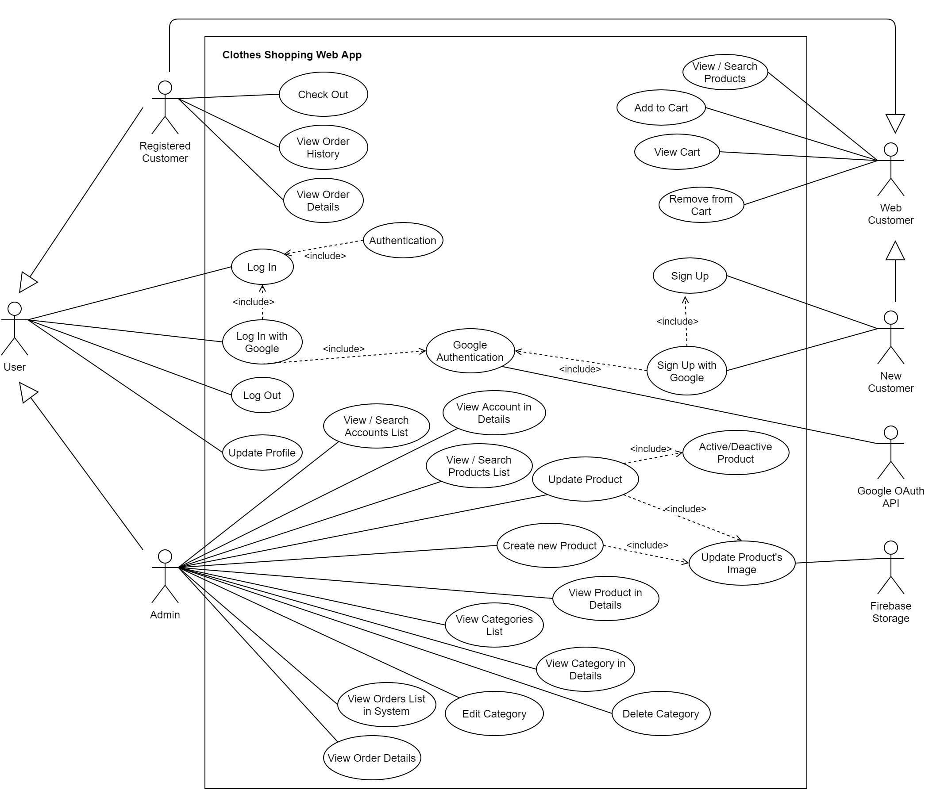
Use Case Diagram

Slide 6
DEMONSTRATION
clothesshoppingwebapp20210713203725.azurewebsites.net

Slide 7


